Slide 1
Chapter 3.2:
Rolle’s Theorem and The Mean Value Theorem
HONORS CALCULUS/CALCULUS

Slide 2
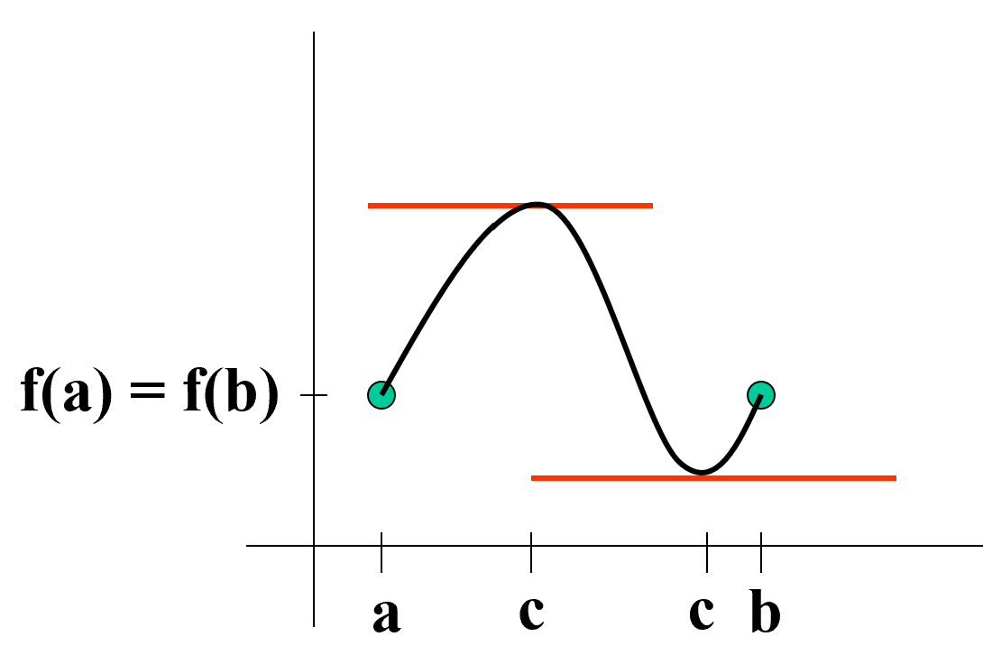
Rolle’s Theorem
Let f be continuous on a closed interval [a, b] and differentiable on the open interval (a, b). If $f\left(a\right)=f(b)$ then there is at least one number c in (a, b) such that $f^{′}\left(c\right)=0.$

Slide 3
Ex. 1) Find the two x-intercepts of $f\left(x\right)=x^{2}−3x+2$ and show that $f^{′}\left(x\right)=0$ at some point between two intercepts.

Slide 4
Ex. 2) Let $f\left(x\right)=x^{4}−2x^{2}$. Find all c in the interval $(−2,2)$ such that $f^{′}\left(x\right)=0$.

Slide 5
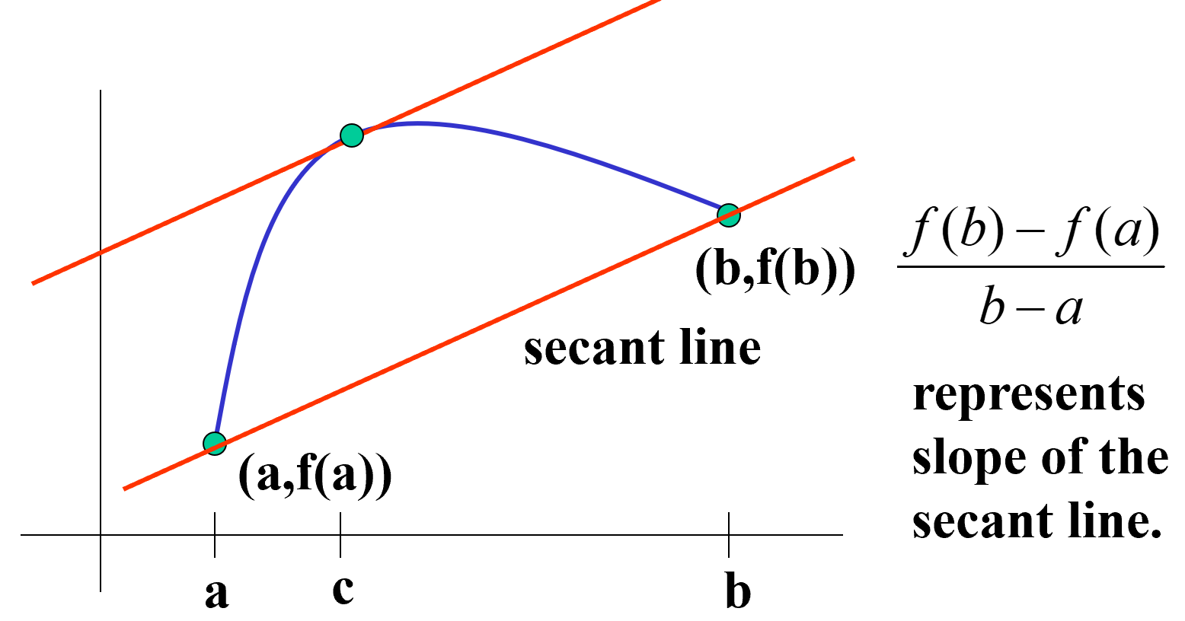
The Mean Value Theorem
If f is continuous on the closed interval [a, b] and differentiable on the open interval (a, b), then $∃$ a number c in (a, b) such that
$$f^{′}\left(c\right)=\frac{f\left(b\right)−f(a)}{b−a}$$

Slide 6
Ex. 3) Given $f\left(x\right)=5−\frac{4}{x}$, find all c in the interval (1, 4) such that the slope of the secant line is equal to the slope of the tangent line.

